Slide 1
Real-time Global Illumination
Introduction to a voxel-based hybrid method
Che Sun
Advisor: Emmanuel Agu
Master’s Thesis
Computer Science Department, WPI

Slide 2

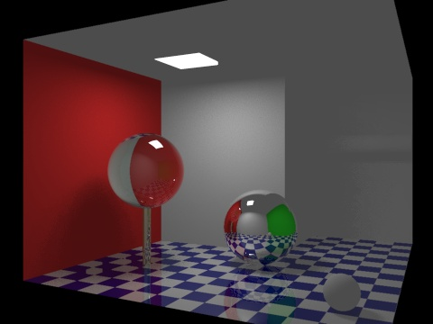
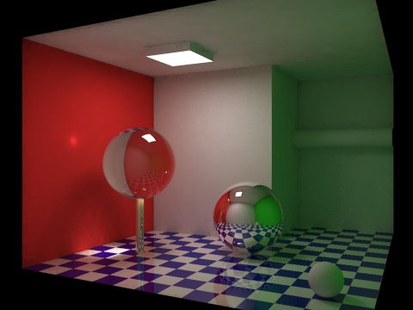
What is Global Illumination?
A general name for a group of algorithms used in 3D computer graphics
Create photorealistic images
Take into account not only the light
coming directly from a light source
(direct illumination), but also indirect
light bounced off from other objects
(indirect illumination)

Slide 3
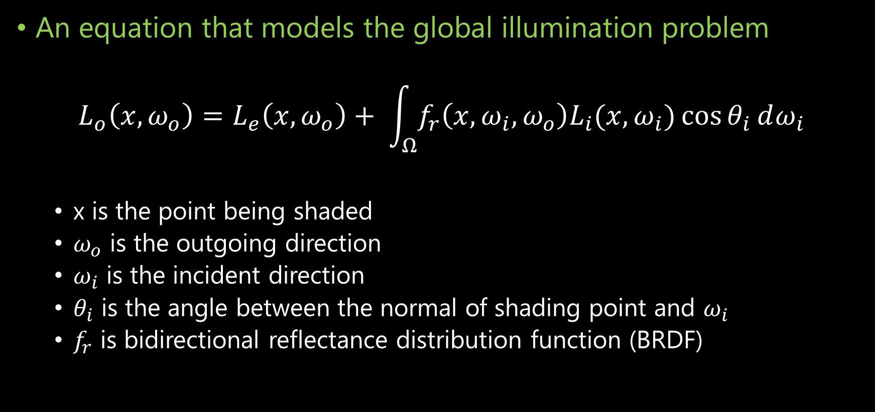
The Rendering Equation
An equation that models the global illumination problem
$$L_{o}\left(x, ω_{o}\right)=L_{e}\left(x, ω_{o}\right)+ \int_{Ω}^{ }{f_{r}\left(x, ω_{i}, ω_{o}\right)L_{i}(x, ω_{i})\cos{θ_{i}}}ⅆω_{i}$$
x is the point being shaded
$ω_{o}$ is the outgoing direction
$ω_{i}$ is the incident direction
$θ_{i}$ is the angle between the normal of shading point and $ω_{i}$
$f_{r}$ is bidirectional reflectance distribution function (BRDF)

Slide 4
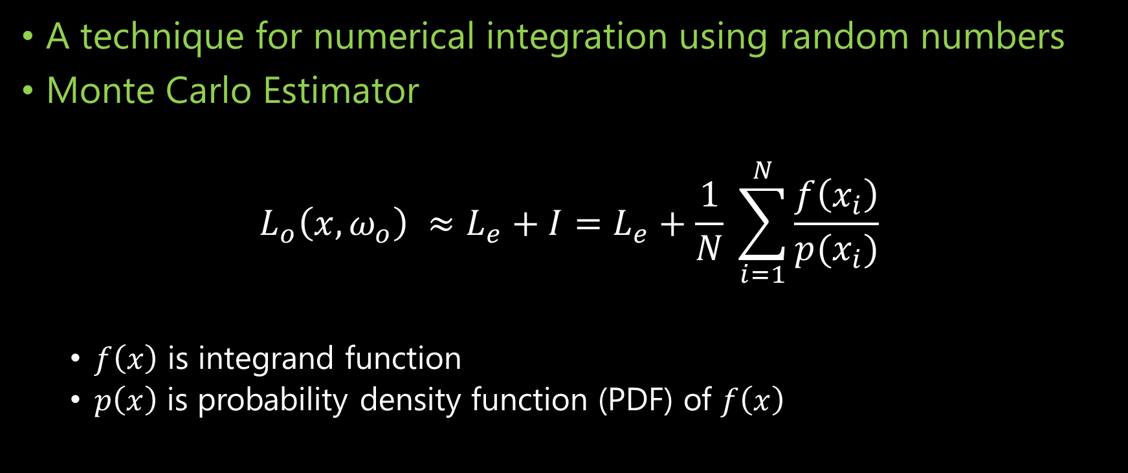
Monte Carlo Integration
A technique for numerical integration using random numbers
Monte Carlo Estimator
$$L_{o}\left(x, ω_{o}\right) ≈L_{e}+I=L_{e}+\frac{1}{N} \sum_{i=1}^{N}{\frac{f\left(x_{i}\right)}{p(x_{i})}}$$
$f\left(x\right)$ is integrand function
$p\left(x\right)$ is probability density function (PDF) of $f\left(x\right)$

Slide 5
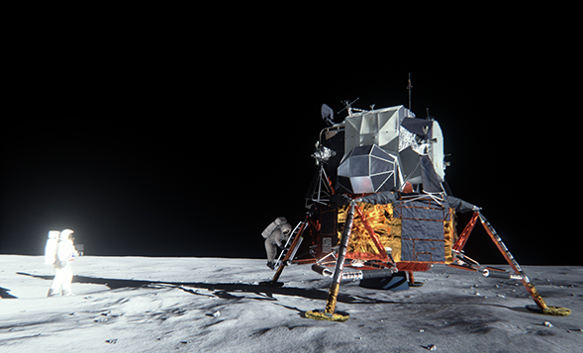
State-of-the-art
Real-time Monte Carlo Methods
Many-light based method
Voxelization based method
Image-space based method
Real-time Partial Differential Equation (PDE) based Method
Numerical PDE solver of diffusion equation

Slide 6
What I have been doing?
Study state-of-the-art real-time global illumination methods
Try to come up with some idea(s) to accelerate real-time GI computation
Try to construct a robust global illumination rendering framework (not a game engine)
Learn advanced shader programming skills, which is very cool!

Slide 7
A Novel Voxel-based Hybrid Method
Based on …
Tokuyoshi, Yusuke, and Shinji Ogaki. "Real-time bidirectional path tracing via rasterization." Proceedings of the ACM SIGGRAPH Symposium on Interactive 3D Graphics and Games. ACM, 2012.
Thiedemann, Sinje, et al. "Voxel-based global illumination." Symposium on Interactive 3D Graphics and Games. ACM, 2011.
Crassin, Cyril, et al. "Interactive indirect illumination using voxel cone tracing." Computer Graphics Forum. Vol. 30. No. 7. Blackwell Publishing Ltd, 2011.

Slide 8
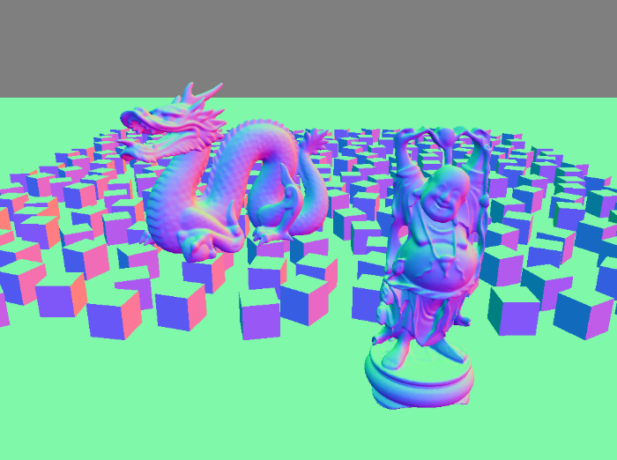
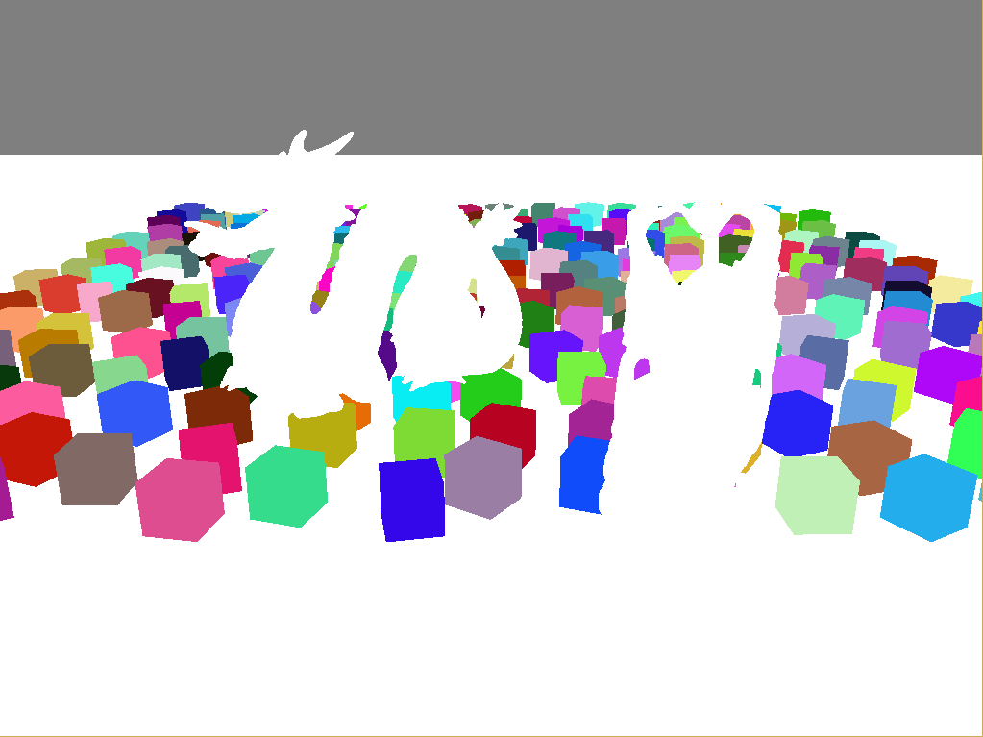
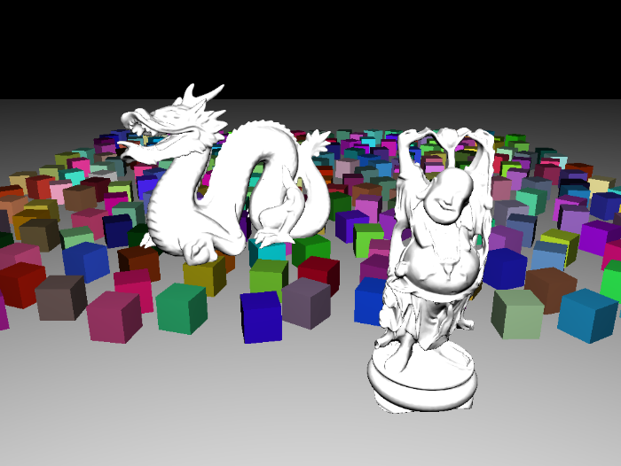
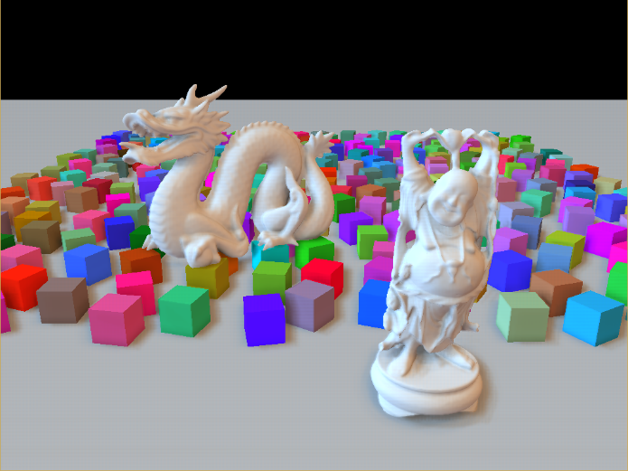

Background
G-buffer and Deferred Shading
A screen-space shading technique
Reduce the lighting
complexity from $O\left(m∗n\right)$
to $O(m+n)$
Stored in Multiple
Render Targets (MRT)

Slide 9
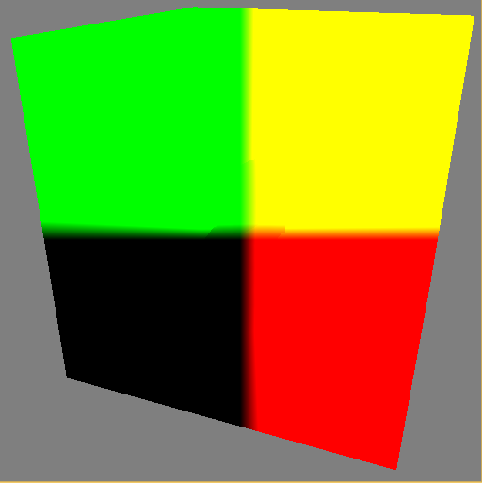
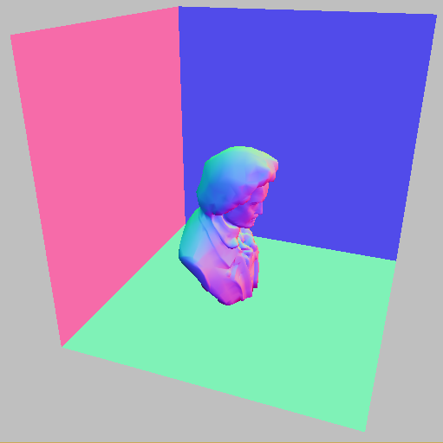
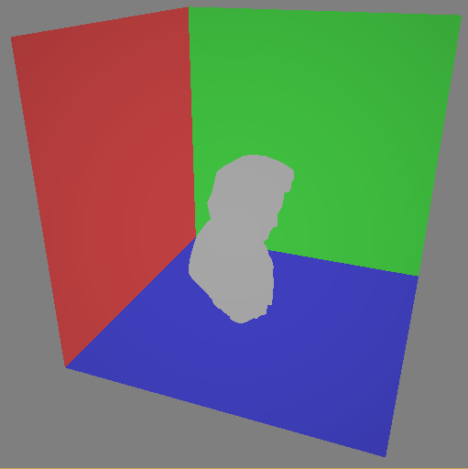
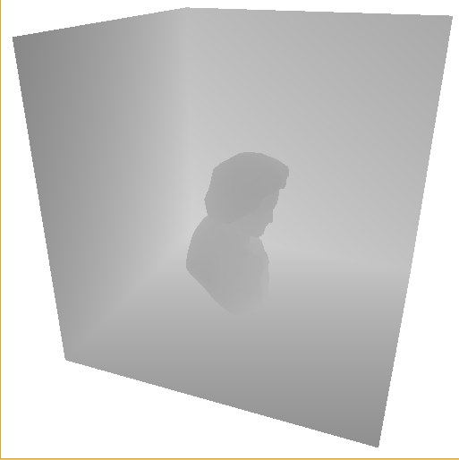
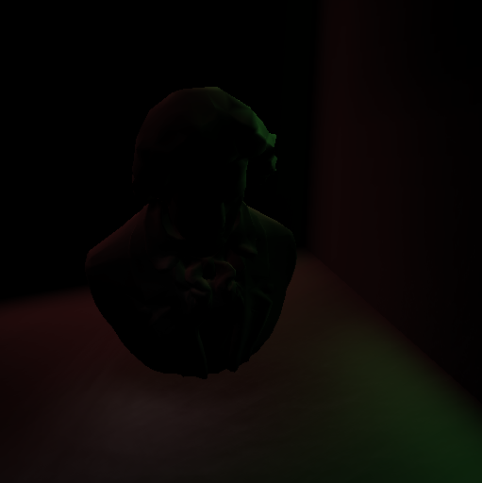
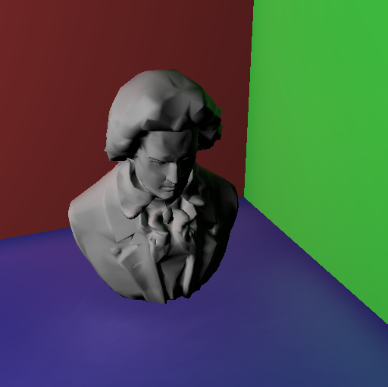
Background
Reflective Shadow Maps (RSM)
Capture direct lighting using MRT similar to G-buffer
Sample RSM and create virtual point lights in image space

Slide 10
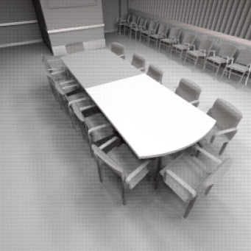
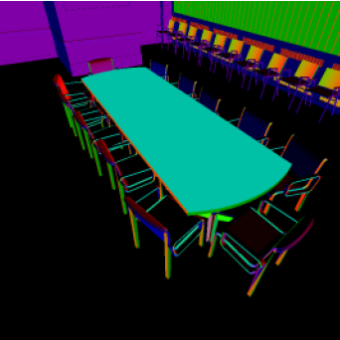
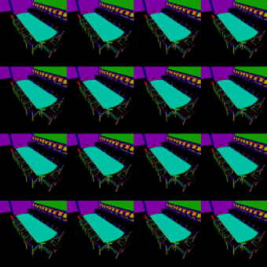
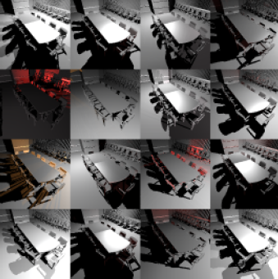
Background
Interleaved Sampling
Form an interleaved sampling pattern
Each pixel only samples a subset of
the original function

Slide 11
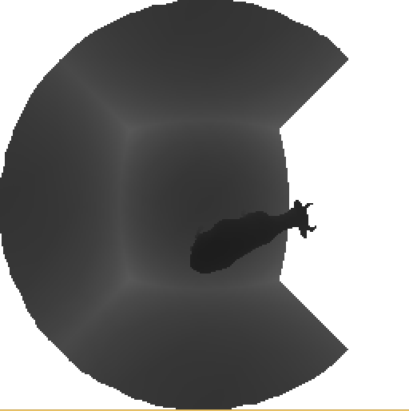
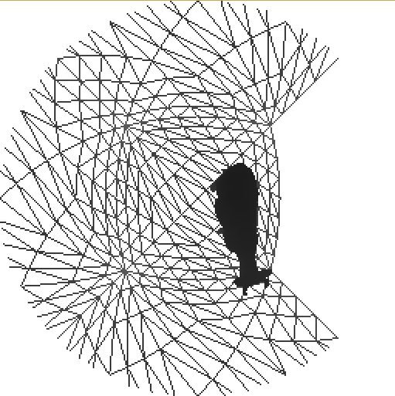
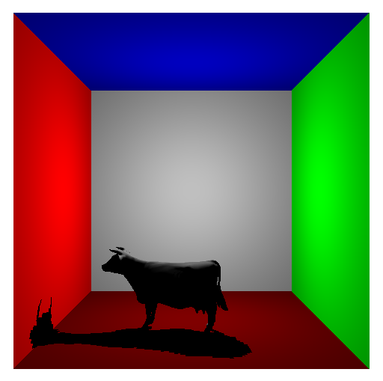
Background
VPL Shadow Maps (Paraboloid Shadow Maps)
Traditional Shadow Maps have limited field of view (FOV)
PSM can cover 180 degree field of view

Slide 12
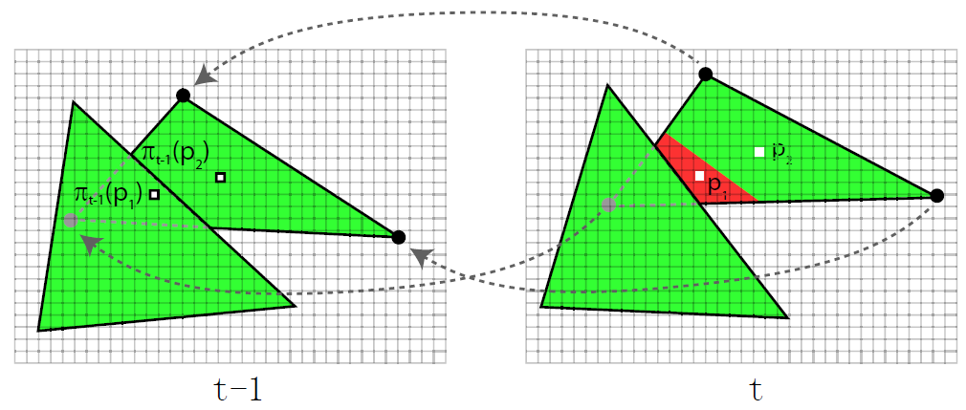
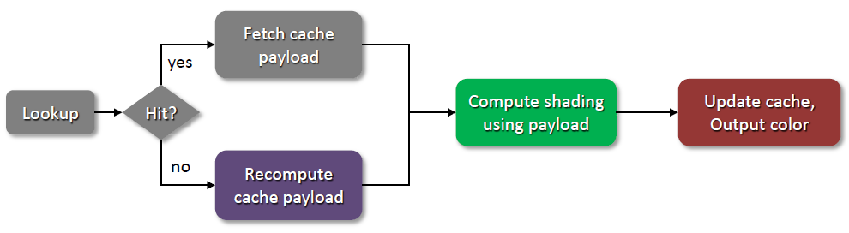
Background
Temporal Coherence
Cache and reuse the
current result
Amortized computation

Slide 13
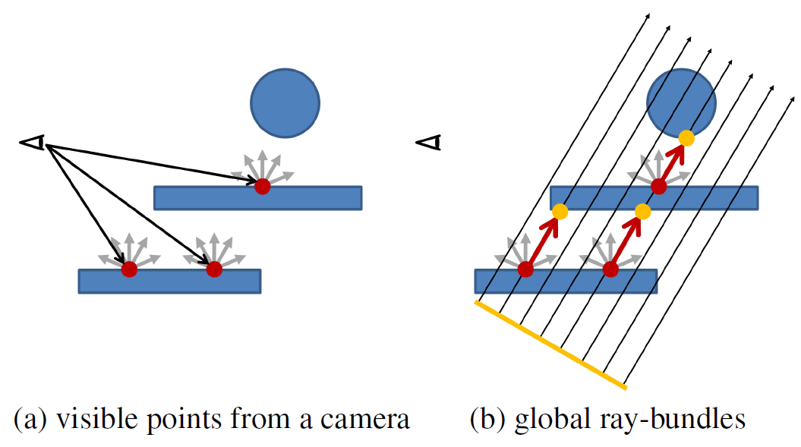
Background
Real-time Global Ray-bundles
Rasterization of Original Scene (Slow)
Rasterization of Point-based Scene (Fast)

Slide 14
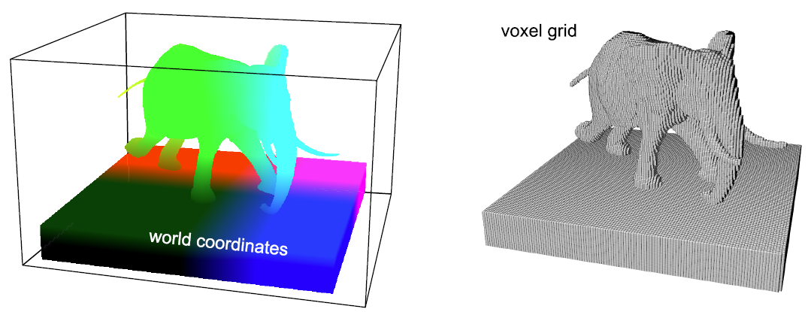
Background
Real-time Voxelization
Discretize the original function in which we are interested
Perform accelerated computation on the voxel grid

Slide 15
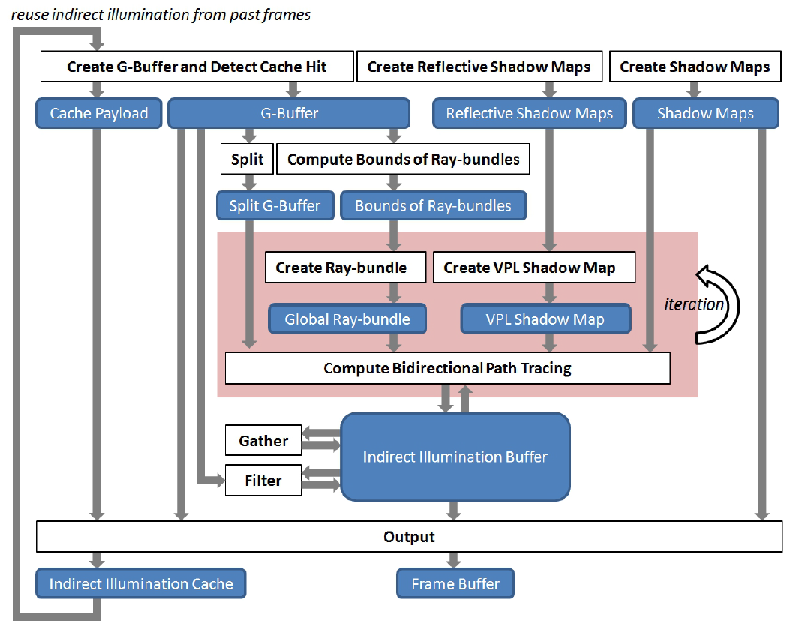
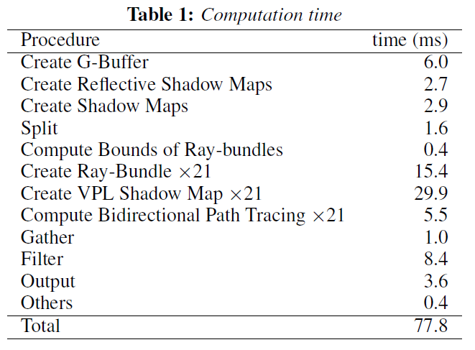
Real-time Bidirectional Path Tracing via Rasterization
Tokuyoshi, Yusuke, and Shinji Ogaki. "Real-time bidirectional path tracing via rasterization." Proceedings of the ACM SIGGRAPH Symposium on Interactive 3D Graphics and Games. ACM, 2012.
Current Issue - still too
SLOW !!

Slide 16
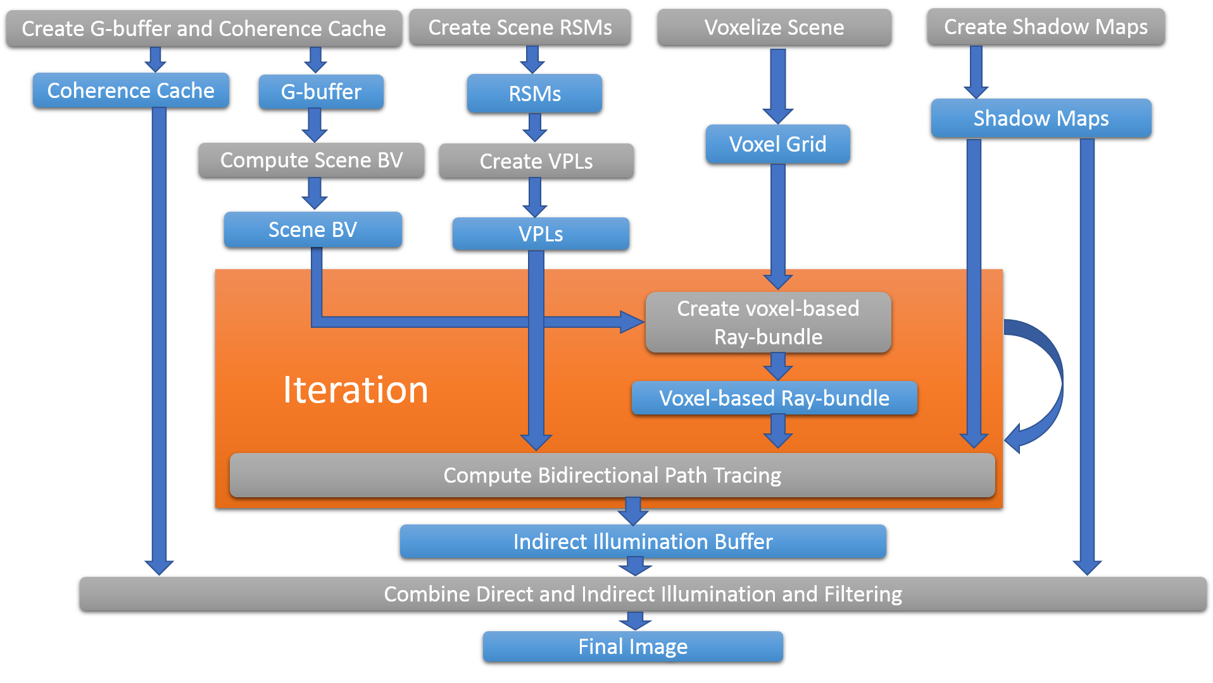
Our Improved Bidirectional Path Tracing
Data
Algorithm

Slide 17
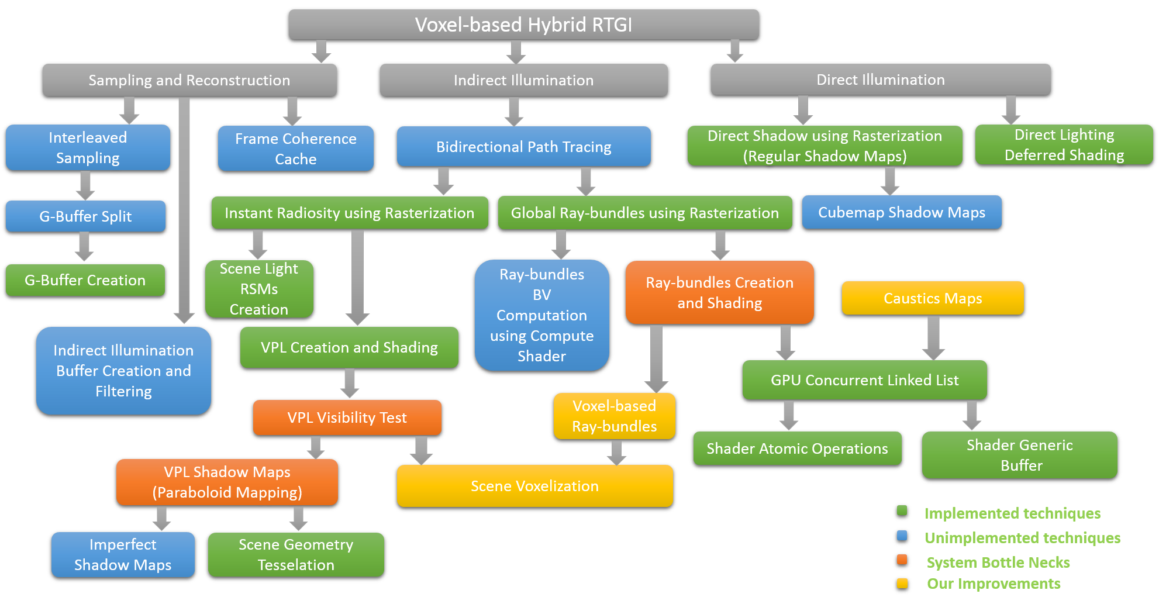
Technique Dependency

Slide 18
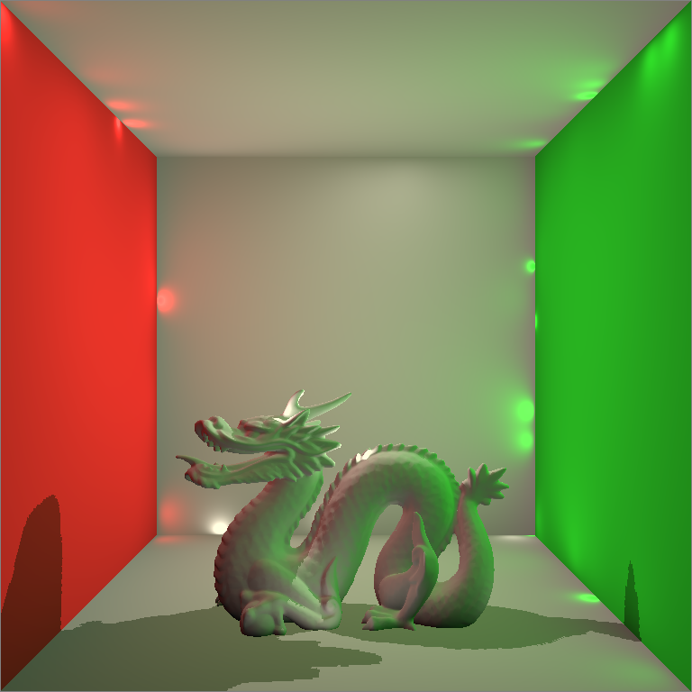
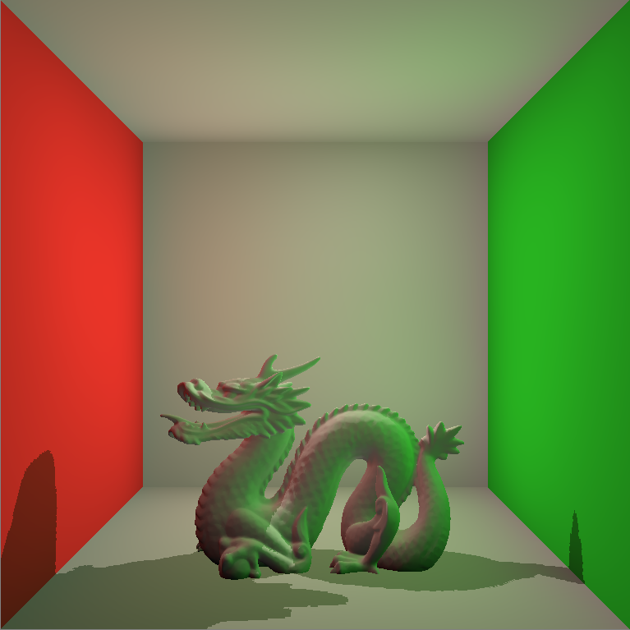
Real-time Virtual Point Lights Rendering
Naïve Implementation of Instant Radiosity
Depends on VPL Shadow Maps (Very slow!)
Classic Singularity Issue

Slide 19
Resolving the Singularity Issue by Clamping
Code Fragment
vec3 indirectColor = vec3(0.0, 0.0, 0.0);
for( int i = 0; i < VPLCount; ++i )
{
VPL vpl = VPLBuffer.vpls[i];
vpl.WorldNormal = vpl.WorldNormal*2.0 - 1.0;
vec3 incidentDir = PositionWorld.xyz - vpl.WorldPosition.xyz;
float len = length(incidentDir);
incidentDir = incidentDir / len;
float cos0 = max(0.0, dot(NormalWorld, -incidentDir));
float cos1 = max(0.0, dot(incidentDir, vpl.WorldNormal.xyz));
float geometricTerm = cos0 * cos1 / max(len*len, BounceSingularity);
indirectColor += MaterialColor.rgb * vpl.Flux.rgb * geometricTerm;
}
indirectColor = indirectColor * 2 * PI;
gl_FragData[0] = vec4(indirectColor, 1.0);

Slide 20
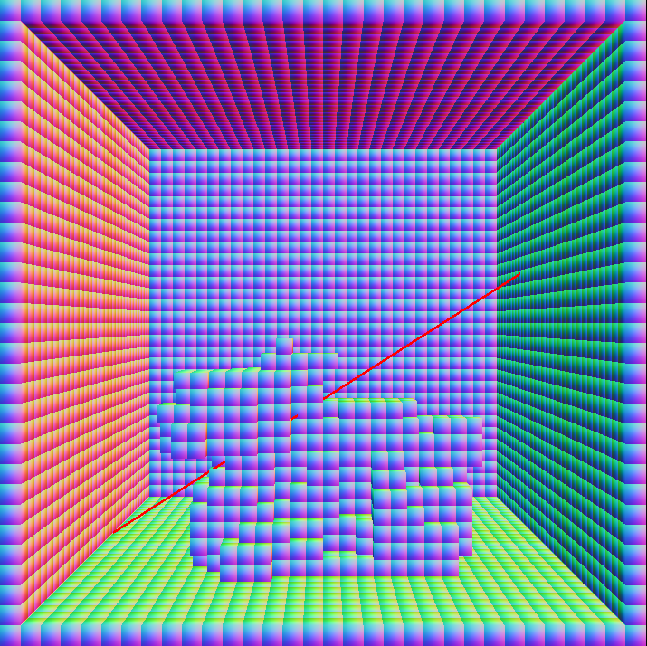
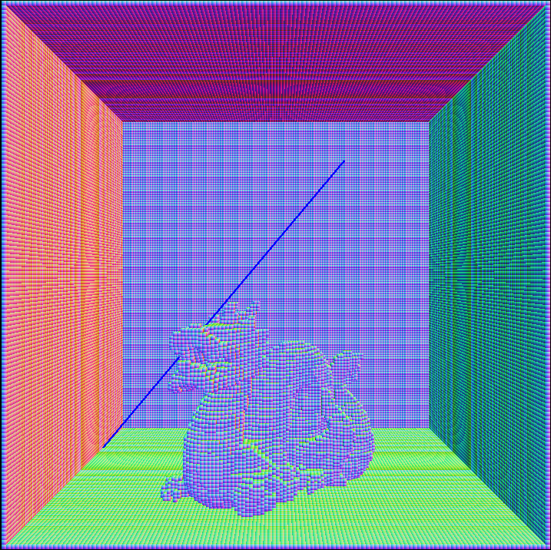
Resolving the VPL Shadow Maps Issue by Voxelization
Visibility Tests by Shadow Maps
Visibility Tests by Voxel Grid

Slide 21
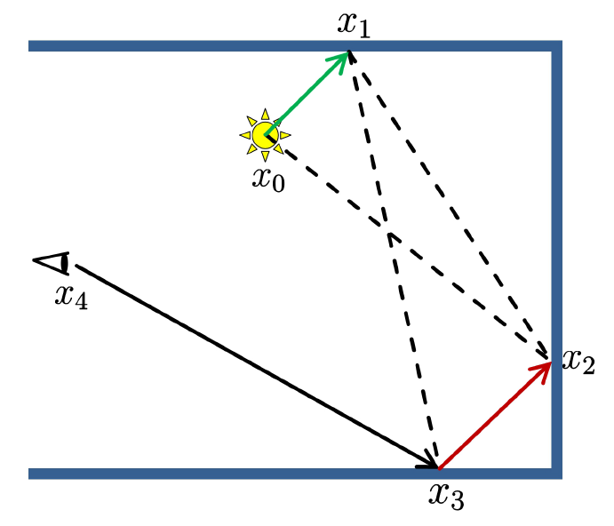
Bidirectional Path Tracing
A Robust Method Resolving the Singularity Issue
Connect the shading path from both
the VPL and Camera
Importance Sampling

Slide 22
Generation of Camera Paths
For each point being shaded, randomly generate N paths
Shooting rays into original scene is slow
Shooting rays into voxel grid is fast
For all points being shaded, randomly generate N paths
Global ray-bundles
Hardware friendly by using GPU rasterizer

Slide 23
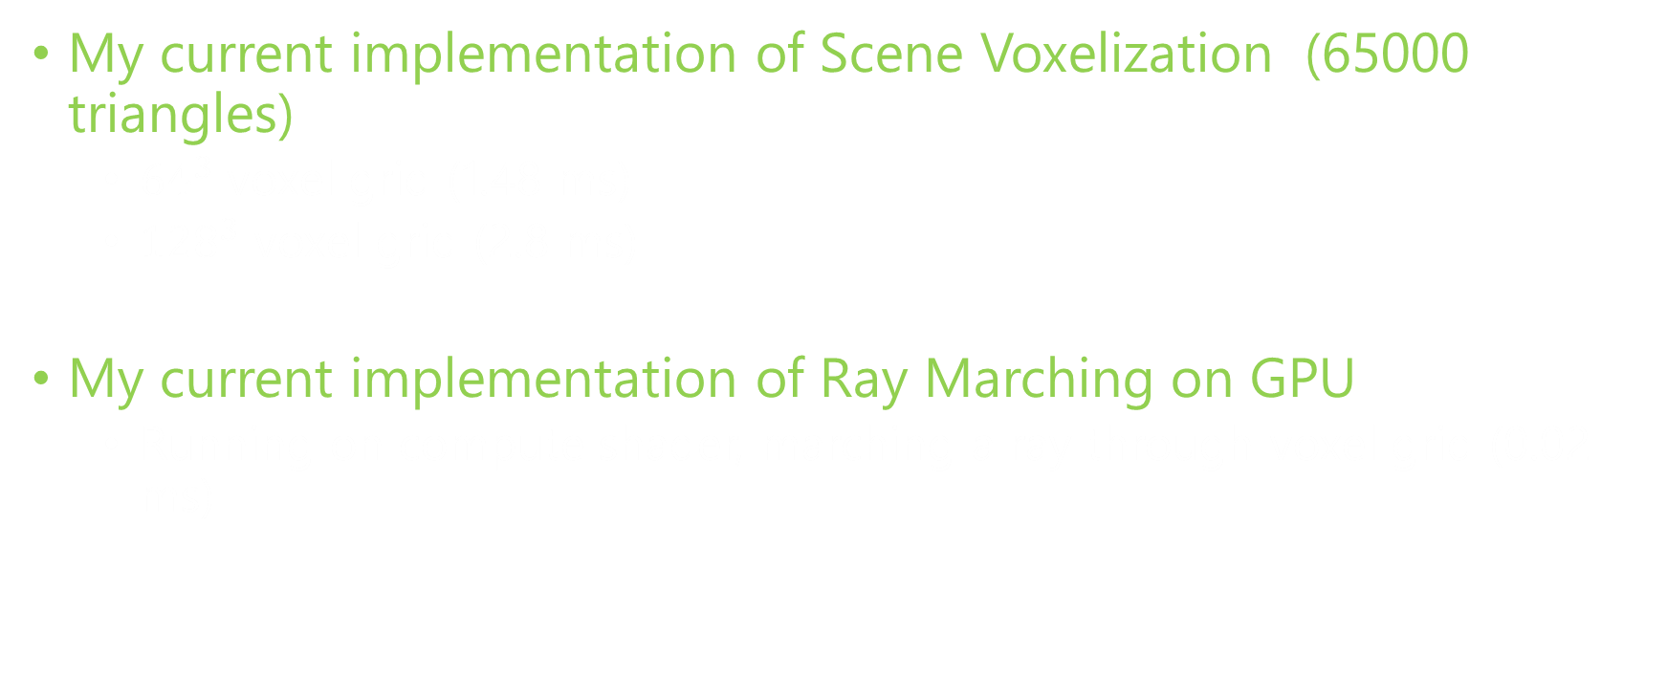
Performance of Voxel-based technique
My current implementation of Scene Voxelization (65000 triangles)
${64}^{3}$ voxel grid (1.48 ms)
${128}^{3}$ voxel grid (2.8 ms)
My current implementation of Ray Marching on GPU
Running on compute shader, marching a ray through voxel grid (0.02 ms)

Slide 24
Generation of Light Paths
Quasi-Monte Carlo Random Walk
Ground truth but slow
Keller, Alexander. "Instant radiosity." Proceedings of the 24th annual conference on Computer graphics and interactive techniques. ACM Press/Addison-Wesley Publishing Co., 1997.
Reflective Shadow Maps
Approximation but fast
Dachsbacher, Carsten, and Marc Stamminger. "Reflective shadow maps." Proceedings of the 2005 symposium on Interactive 3D graphics and games. ACM, 2005.

Slide 25
Advanced Shader Programming via Shader Model 5.0
OpenGL 4.3 Specification
Shaders
Vertex Shader
Tesselation Control Shader
Tesselation Evaluation Shader
Geometry Shader
Fragment Shader
Compute Shader
Improved GPU Memory Programming Model
Shader Atomic Operations
GPU Memory Random Access Model (Structured Buffer)
Avoid CPU-GPU Interaction
Indirect Command Buffer

Slide 26
Research Schedule
January – April 2014
Learn OpenGL shader programming, Spherical harmonics, Light Propagation Volume, Reflective Shadow Maps, SSDO, Instant Radiosity, Many-light methods then Implement SSDO.
May – August 2014
Learn OpenCL and OpenGL compute shader programming, Real-time Bidirectional Ray Tracing via Rasterization, GPU concurrent link list technique, Global Ray-bundles, Imperfect Shadow Maps, Incremental Instant Radiosity and Interleaved Sampling. Meanwhile, implement Reflective Shadow Maps, GPU concurrent link list and global ray-bundles.
September – December 2014
Learn OpenGL geometry and tessellation shader programming then investigate Real-time voxelization, Temporal Coherence, Paraboloid Shadow Map, Caustic Maps. Meanwhile, implement VPL demo, voxelization demo and combine VPL and voxelization together to support voxel-based VPL visibility test.
January – March 2015
Implement voxel-based global ray-bundles and combine all the sub-systems together, then integrate caustic maps into the system.
March – April 2015
Write thesis, do thesis presentation and submission.

Slide 27
Thank You!
Any Questions? csun2@wpi.edu

